Slide 1

IDENTIFICATION OF BRAIN TUMOR USING DEEP LEARNING ALGORITHMS BASED ON CT-SCANNED IMAGES
PRASHANTH REDDY KOPPULA - 700761149

Slide 2
CONTENTS
MOTIVATION
PROBLEM STATEMENT
OBJECTIVES
CONTRIBUTIONS
RESULTS
CRITICAL ANALYSIS
CONCLUSION
REFERENCES

Slide 3
MOTIVATION
Brain tumors are one of the most challenging medical conditions to diagnose due to the brain's complexity and the subtlety of the early signs. Traditional diagnostic methods, such as MRI, CT scans, and X-rays, are essential, but they often require expert interpretation and are subject to variability in image quality and human error.
Recent breakthroughs in deep learning and artificial intelligence have demonstrated the potential to transform medical imaging. These technologies offer the promise of automating and enhancing the diagnostic process, reducing human error, and increasing the speed and accuracy of tumor detection.

Slide 4
PROBLEM STATEMENT
Recognition of brain tumor in CT scanned images is a diﬃcult task due to complexity of size and location variability. In this research brain tumor is detected using deep learning algorithms irrespective of size and shape of the CT scanned image.

Slide 5
OBJECTIVE
The objective of this project is to build a robust CT scan based brain diagnosis system using convolutional neural networks.
To implement the system in hospitals for easy results and with high accuracy.

Slide 6
CONTRIBUTIONS
FILTERS : -There are a lot of methods for realizing the classiﬁers. We select machine learning algorithms to build our classiﬁers. “Gaussian ﬁlter”, “Adaptive median Filter”, “CNN ﬁlter”. These ﬁlters are applied on the data set to predict the disease.
ACCURACY GRAPH :-This module is used to identify the ﬁlter which is eﬃcient to other ﬁlters using a comparison graph for both accuracy and error prediction.
ERROR GRAPH : This module is used to identify the error using a comparison graph for all three ﬁlters.
PREDICT DISEASE :-This module displays whether the uploaded image is normal or not.

Slide 7
PROPOSED SYSTEM
All existing techniques such as median ﬁltration or Gaussian ﬁltration has limitation in smoothing image pixels so I am overcoming such limitation by applying Adaptive Median Filtration (AMF).
AMF algorithm will adjust image resolution by ﬁnding maximum and minimum intensity pixels. After adjusting pixels by applying AMF, CNN networks are used which will extract deeper features from image vector which can helps in detecting minute features for accurate prediction.
The extracted features will be passed to gradient boosting classiﬁer to predict given image is normal or abnormal.

Slide 8
CRITICAL ANALYSIS
The brain tumor detection technology based on CT scans provides a more accurate diagnosis. Preprocessing, feature extraction, and classiﬁcation are the three categories of operatIons followed by any medical image processing technique. Segmentation, transformation, and ﬁltration are all available at the preprocessing stage.
To categorize a dataset comprising various numbers of brain diseases, a couple of profound learning classiﬁers were utilized in conjunction with discrete wavelet change and head parts examination. Moreover, brain tumor image segmentation is used in numerous BTS applications to classify pixels.

Slide 9
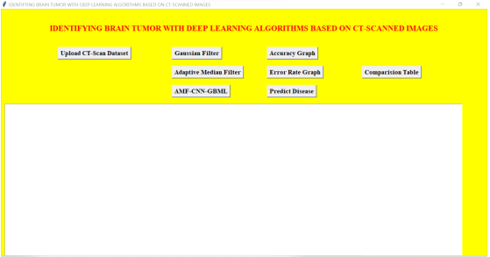
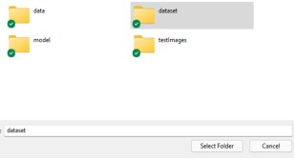
RESULTS

Slide 10
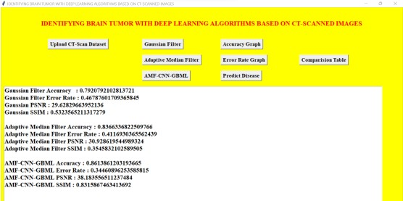
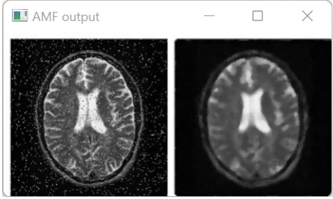

Slide 11
CONCLUSION
After implementing three different algorithms, as the result shows, the convolutional neural network gradient boosting machine learning algorithm has got the highest accuracy and the least error rate and also the peak signal-to-noise ratio is 38, which is relatively higher. This increases the hope in advancing the learning in convolutional neural networks for this kind of project.

Slide 12
REFERENCES
Saba, T., Mohamed, A. S., El-Affendi, M., Amin, J., & Sharif, M. (2020). Brain tumor detection using fusion of hand crafted and deep learning features.
Cognitive Systems Research, 59, 221-230.
Toğaçar, M., Ergen, B., & Cömert, Z. (2020). BrainMRNet: Brain tumor detection using magnetic resonance images with a novel convolutional neural network model. Medical hypotheses, 134, 109531.
Abdalla, H. E. M., & Esmail, M. Y. (2018, August). Brain tumor detection by using
artiﬁcial neural network. In 2018 International Conference on Computer, Control, Electrical, and Electronics Engineering.
Woźniak, M., Siłka, J., & Wieczorek, M. (2021). Deep neural network correlation
learning mechanism for CT brain tumor detection. Neural Computing and Applications, 1-16.

